Slide 1
Unity Catalog
Unified governance for all data and AI assets

Slide 2




Governance for data and AI is complex
Permissions on files
No row and column level permissions
Inflexible when policies change
Data Lake
Data analyst
Permissions on tables and views
Can be out of sync with data
Metadata
Data engineer
Permissions on tables, columns, rows
Different governance model
Data warehouse
Permissions on ML models, dashboards, features, …
Yet another governance model
Data scientist
ML models, dashboards

Slide 3

Databricks Unity Catalog
Unified governance for all data and AI assets
Unity Catalog
Data Lake
Data analyst
Metadata
Data engineer
Data warehouse
Data scientist
ML models, dashboards

Slide 4





Databricks Unity Catalog
Unified governance for all data and AI assets
Centralized governance for data and AI
Built-in data search and discovery
Performance and scale
Automated lineage for all workloads
Integrated with your existing tools
Lakehouse Platform
Data
Warehousing
Data Engineering
Data Streaming
Data Science
and ML
Unity Catalog Fine-grained governance for data and AI
Delta Lake
Data reliability and performance
Cloud Data Lake
All structured and unstructured data

Slide 5
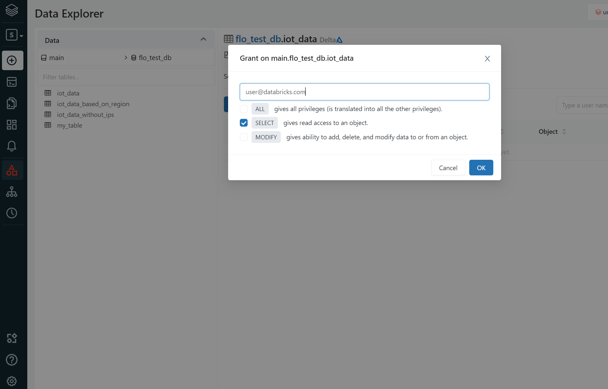
Centralized governance for data and AI
Create a single source of truth for your data with centralized metadata and user management
Centrally manage access permissions and audit controls for files, tables across all workspaces and workloads using open standard ANSI SQL
Enable fine-grained access controls on tables, files, rows, and columns

Slide 6
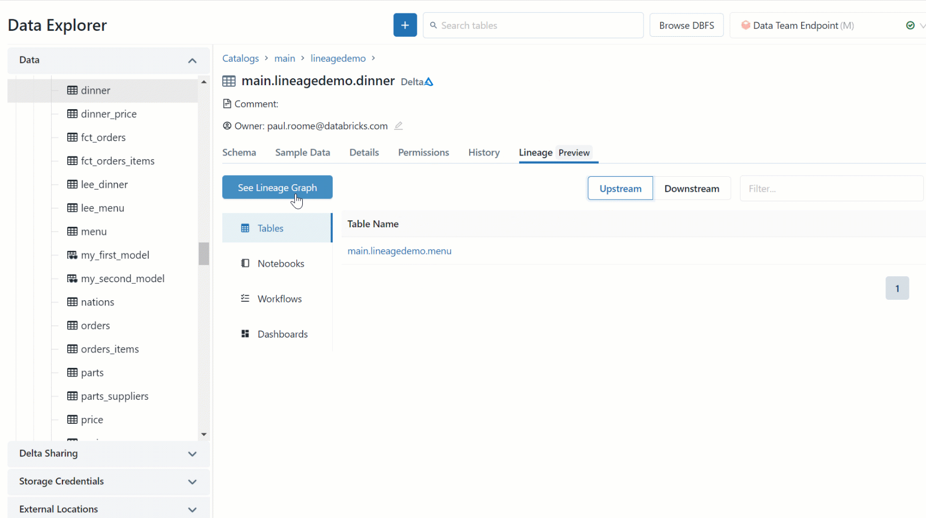
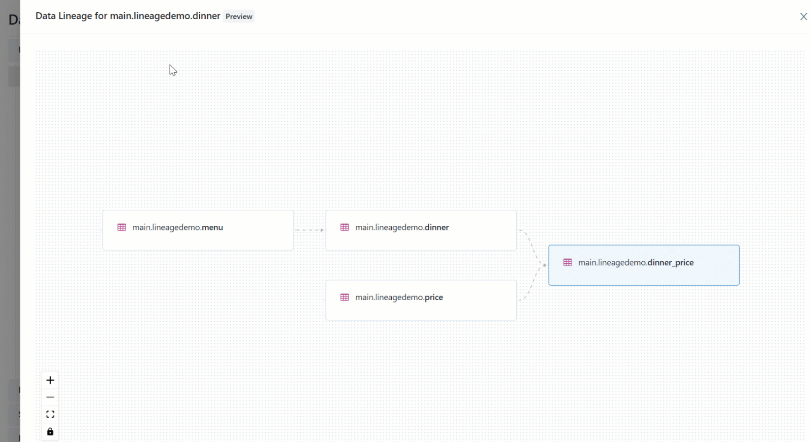
Automated lineage for all workloads
Get an end-to-end visibility into how data flows in your organization from source to consumption with built-in data lineage
View lineage across tables, columns, notebooks, workflows, dashboards
Captured in real time across all workloads in SQL, Python, Scala, and R
Export API to enable partner integrations

Slide 7
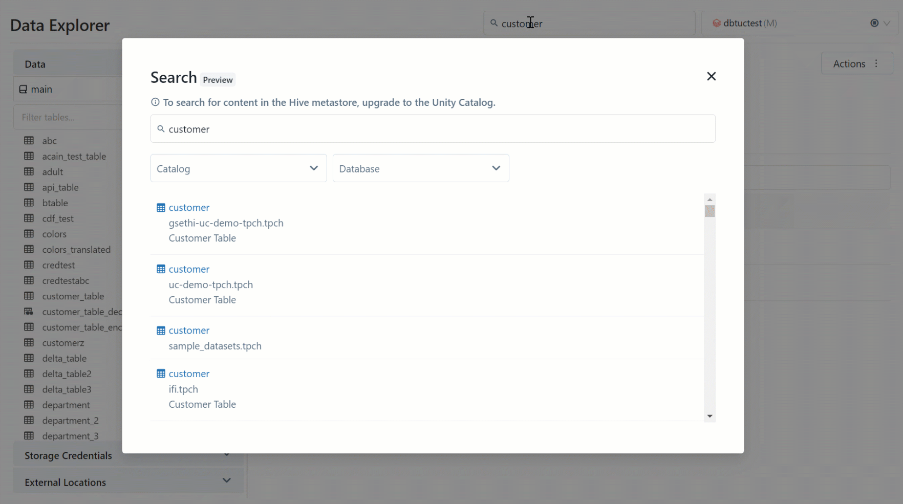
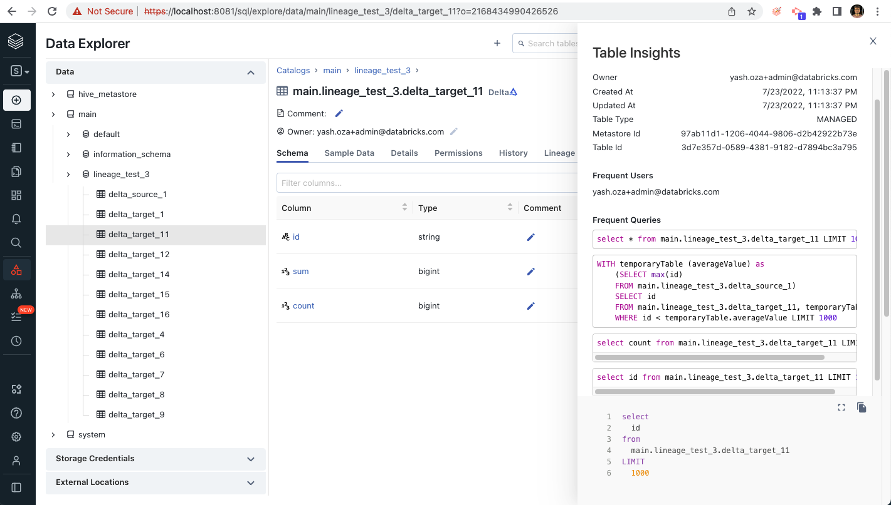
Built-in search and discovery
Quickly find, understand, and reference data from across your data estate with a unified data browsing experience
Secure by default—leverages common permission model from Unity Catalog
Auto-generated data insights to understand your data

Slide 8
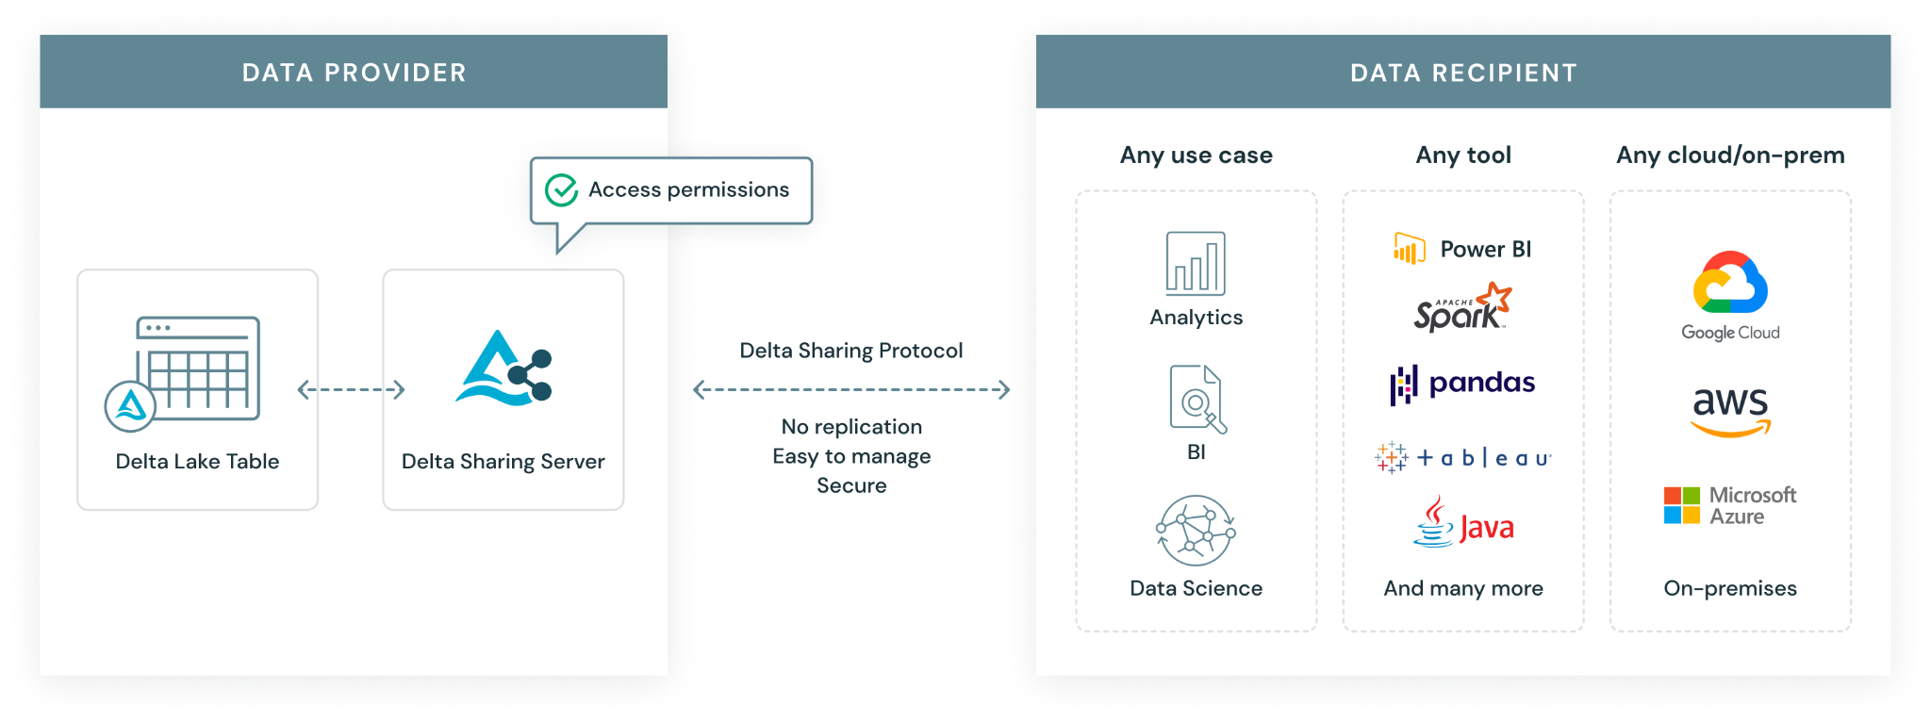
Secure data sharing and collaboration
Securely share live data from your lakehouse to any computing platform
Eliminate unnecessary data replication, and vendor lock-in
Centrally manage, govern, monitor usage and audit access to shared data with ease

Slide 9

Introducing Unity Catalog
Unified view of your data estate via a centralized metadata and user mgmt
Without Unity Catalog
With Unity Catalog
Databricks Workspace
Databricks Workspace
Unity Catalog
User Management
Metastore
User Management
User Management
Databricks Workspace
Databricks Workspace
Metastore
Metastore
Clusters SQL Endpoints
Clusters SQL Endpoints
Clusters SQL Endpoints
Clusters SQL Endpoints

Slide 10
Databricks Accounts and the Cloud Provider Hierarchy
Account Console
Databricks Account
AAD Tenant
Azure Subscription
Azure Subscription
Databricks Workspace
Databricks Workspace

Slide 11




Identity Federation with Unity Catalog
Identity Provider
Unity Catalog Account Console
Group 1
Group 2
User/group sync (e.g. SCIM)
Account Level User Mgmt
Group 3
Group 4
Group 1
Group 2
Group 4
Federate identities
Databricks Workspace 1
Databricks Workspace 2
Databricks Workspace 3
Group 1
Group 1
Group 4
Group 2
Group 4

Slide 12

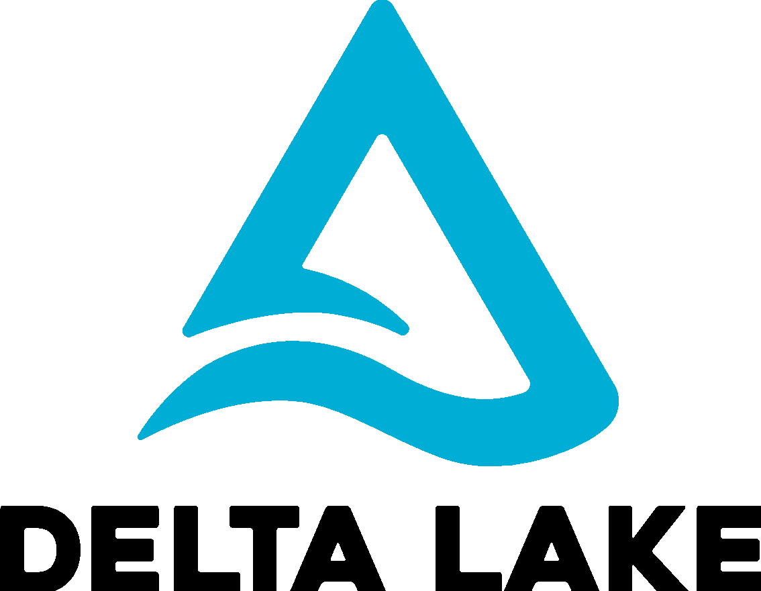

Unity Catalog - Components
Centralized Governance
Audit Log
Metastore
Account Level User Mgmt
Unity Catalog
Lineage Explorer
Credentials
Data Explorer
ACL Store
Access Control
Cloud Storage (ADLS)
Databricks Workspace
✔
user
* ADLS Container
* Unity Catalog will support any data format (table or raw files)

Slide 13


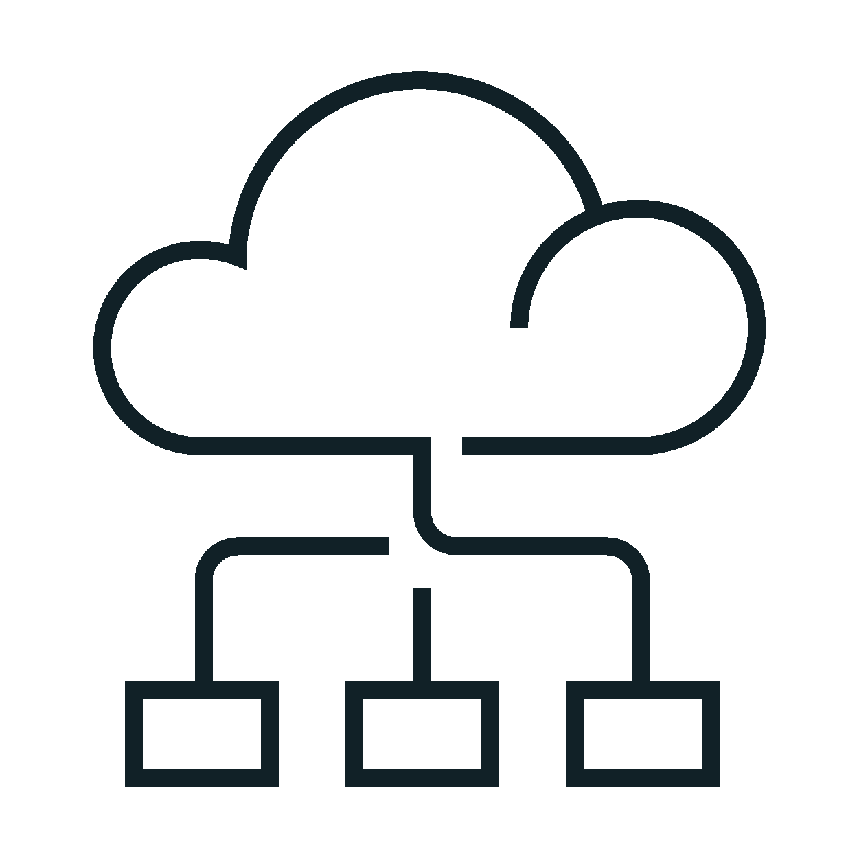

Life of a query with Unity Catalog
Creates a Managed Identity
Creates storage credentials/ external locations in Unity Catalog
Defines access policies in Unity Catalog
Admin
Check namespace , metadata and grants
Write
audit log
Cluster or SQL endpoint
2
Audit log
Send query (SQL
Python, R, Scala,)
Return list of paths/data files and scoped down temporary tokens
User
1
4
3
Assume Managed Identity
8
Send result
Request/ingest data from paths/data files with temporary tokens
5
Cloud Storage
Enforce policies
7
6
Return data
(ADLS)

Slide 14
The three level namespace of UC
(Unity) Metastore
Unity Catalog
…
(Unity) Metastore
Catalog
…
Schema (Database)
Managed Table
External table
Databricks Account
Catalog
…
assigned to
Schema (Database)
External Table
Managed Table
Databricks Workspace
View
Databricks Workspace
View
SELECT * FROM catalog1.database1.table1;

Slide 15
Hive Metastore is integrated into UC
(Unity) Metastore
Unity Catalog
…
(Unity) Metastore
Catalog
…
Schema (Database)
Managed Table
External table
Databricks Account
Catalog
…
assigned to
Schema (Database)
External Table
Managed Table
Databricks Workspace
View
Databricks Workspace
associated with
Hive Metastore
View
SELECT * FROM catalog1.database1.table1;
SELECT * FROM hive_metastore.database2.table2;

Slide 16



Managed Data Sources & External Locations
Audit log
Unity Catalog
External Locations & Credentials
Access Control
Cloud Storage (S3, ADLS, GCS)
Managed tables
Managed Data Sources
Managed container / bucket
Cluster or SQL endpoint
User
External tables
External container / bucket
…
External Locations
Files in Cloud Strg
External container / bucket

Slide 17
Metastore, external locations and credentials
Catalog Storage
Cloud Storage (ADLS)
Managed Table
Container/bucket for Managed Tables
Catalog
Schema (Database)
External Locations
External Table
Location for External Data sources
location
Location for External Data sources
Container/bucket for External Tables
Directory *
location
Meta store
Location for External Data sources
Location for External Data sources
Credentials
Container/bucket for External Files
Example (permissions ignored for simplicity):
CREATE STORAGE CREDENTIAL finance_cred …
CREATE EXTERNAL LOCATION finance URL abfss://…/finance WITH (STORAGE CREDENTIAL finance_cred);
CREATE EXTERNAL TABLE forecast LOCATION abfss://…/finance/forecast;
CREATE DIRECTORY eu_invoices LOCATION abfss://…/finance/eu/invoices;
credential
credential
credential
*
* coming soon

Slide 18
Object relations before Unity Catalog
sync users and groups
Databricks Workspace
(Control Plane)
User / Group management *
Identity Provider
has
Cluster / SQL Endpoint
read / write
Cloud Storage #
has
read / write
Hive Metastore
database/table locations
has
* An integrated module of every Databricks Workspace
⁺ Could also be an external Metastore
# Any accessible cloud storage or the root container (dbfs)

Slide 19
Object relations with Unity Catalog (UC)
Databricks Account Console
Databricks Account
Account Level
User Management
sync users and groups
Identity Provider
has
has
has
has
uses
Databricks Workspace
(Control Plane)
assigned to
(Unity) Metastore
links to and manages
Default Cloud Storage
has
has
has
has
Cluster / SQL Endpoint
External Cloud Storages
has
Recipients
Credential Storage
Catalog Storage
External Locations
links to
Delta
Sharing
read / write
can access
has
Shares
has
catalog.db.table
Hive Metastore
has
Notes:
Using Unity Catalog is optional. Workspaces can still use a Hive Metastore only
There can be more than one Unity Metastore (UC) per Databricks Account (e.g. for regional isolation or for isolation of lines of business)
Every workspace can only attach to one UC Metastore, however one Unity Metastore can be assigned to several Workspaces

Slide 20
UC and Delta Sharing

Slide 21







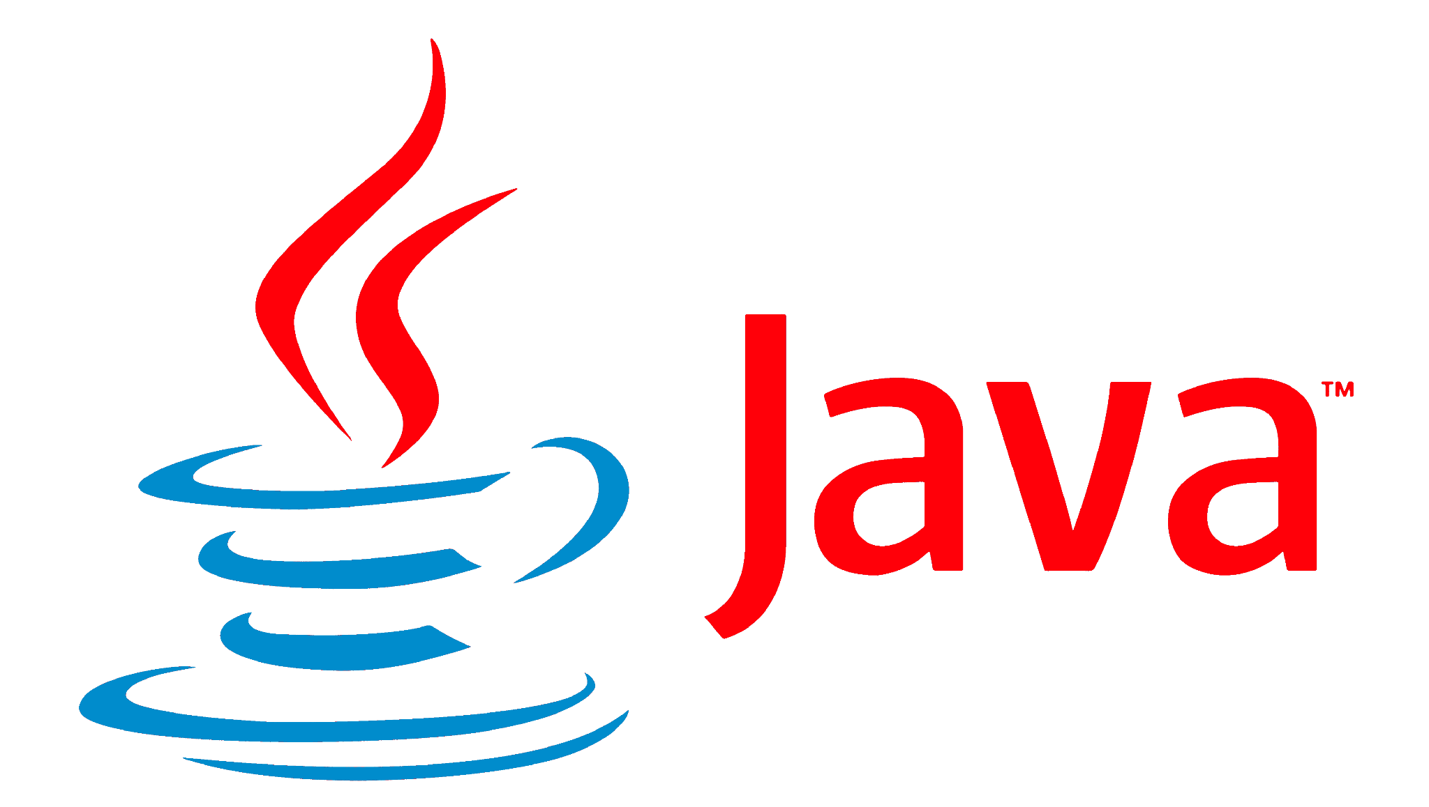
A simple, open and easy approach to data sharing
Reduce data sharing and collaboration from days to real-time
Data Provider
Data Recipients
Power BI
Authorize Authenticate
Data Analyst
Data Scientist
Delta Lake
Delta Sharing Server
On-Prem
Multi-Cloud
No replication
Easy to manage
Data Engineer
…
Delta Sharing Client

Slide 22
Unity Catalog & Delta Sharing - Components
Centralized Governance
Audit Log
Identity Provider
Metastore
Account Level User Mgmt
Unity Catalog
Lineage Explorer
Credentials
Data Explorer
ACL Store
Cloud Storage (S3, ADLS, GCS)
Access Control
Databricks Workspace
user
✔
container / bucket
X
✔
container / bucket
Delta Sharing Client
user
Delta Sharing Server
✔
Short-lived token
X
Access denied

Slide 23


Under the Hood
Data Provider
Data Recipient
Delta Sharing Protocol:
Client authenticates to Sharing Server
Client requests a table (including filters)
Server checks access permissions
Server generates and returns pre-signed short-lived URLs
Client uses URLs to directly read files from object storage
Authorize Authenticate
Delta Sharing Protocol
request table
pre-signed short-lived URLs
Delta Table
Delta Sharing Server
Delta Sharing Client
Notes:
Sharing happens on Delta part files, supporting full tables, partitions, delta versions, …
Client is system independent, just needs to be able to read parquet files
In Databricks Sharing Server and ACL checks are integrated with Unity Catalog
Power BI
direct access to files (parquet format) in the object store
Parquet files
…

Slide 24


Streamlined Sharing with Delta Sharing
Delta Sharing cuts collaboration time with partners from days to real-time.
Data Provider
Data Recipient
Prepare
Share
Query data in real-time
(optional)
Source table
Refined table
Delta Sharing Server
Multi-cloud
No replication
Easy to manage
Delta Sharing Client
Trigger Activity
Access data in real-time
Actionable Data

Slide 25

Databricks-to-Databricks (D2D) Sharing
Databricks-to-Databricks Sharing
Delta Sharing *
Databricks Lakehouse
Databricks Lakehouse
Databricks Lakehouse
Databricks Lakehouse
Provider
Meta store
Object store
Meta store
Object store
Meta store
Object store
Delta Sharing Server + UC
Object store
cloud provider 1
share
company 1
cloud region 1
share
share
share
cloud
region 2
(D2D)
(D2D)
(D2D)
company 2
cloud provider 2
Databricks Lakehouse
Databricks Lakehouse
3rd party Data Platform
read
read
read
auth
read
Recipient
Workspace
Meta store
Work spaces
Meta store
Work spaces
Meta store
Work spaces
3rd party tool
Different cloud regions
Different companies
Different cloud providers
Different technologies
Provide access to the data on a network level
* Implementing the Delta Sharing protocol, 3rd parties can act as a data provider

